Slide 1
The Python Standard Library
Useful modules for quick implementations

Slide 2

Isn’t Python alone powerful enough, you poser ?
Tons of standard modules included in the base Python installation
You can use them on training websites and during contests
Many tools implementing commonly functions commonly used in competitive programming

Slide 3
Hold on, there’s a fuckton of them, which ones should I try ?
BIG ONES
itertools : operations on iterators, generate combinations…
math : math
heapq : Implementation of a priority queue
collections : data structures
bisect : Array bisection algorithm

Slide 4
Itertools (not gonna lie, it’s mainly for brute-forcing)
Main goal: to create effectives iterators for you to work on
Itertools is optimized for the creation of iterators
Will allow you to gain time if you know what you are looking for
Really useful to exploring basic combinatorics spaces

Slide 5
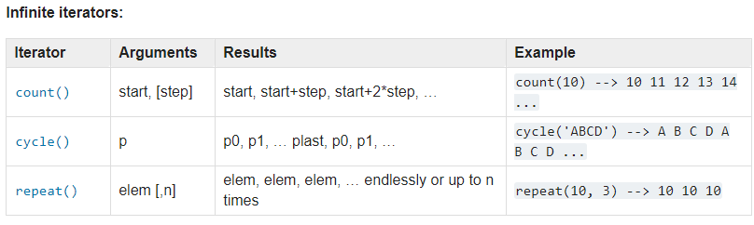

Itertools (you are not going to count to infinity, are you ?)

Slide 6

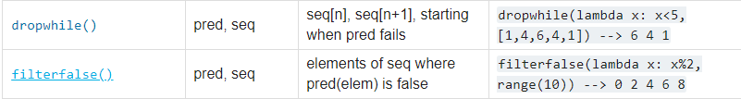
Itertools (who knows… it might be useful)

Slide 7
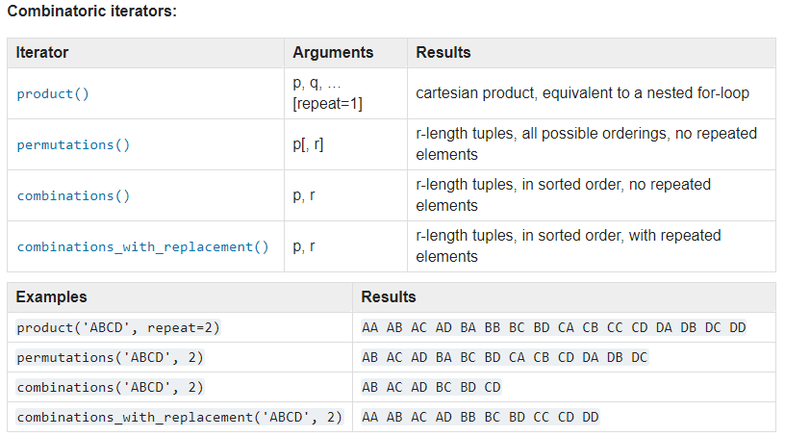

Itertools (try doing that on O(n³) )

Slide 8
Math, Some situational Functions...
math.comb(n, k)
math.factorial(x) Deprecated since version 3.9
math.gcd(*integers) only two arguments were supported before 3.9
math.trunc(x)
math.exp(x)
math.log(x[, base]) math.cos(x)
math.dist(p, q)
math.degrees(x)

Slide 9
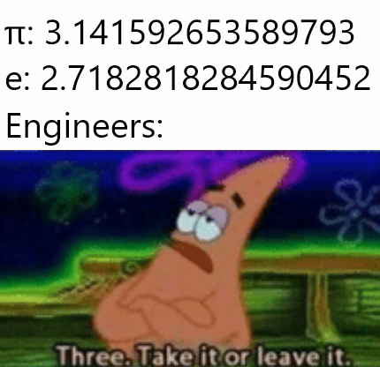
...and some Constants
math.pi
math.e
Math.inf equivalent to float(‘inf’)

Slide 10
Heapq : a priority queue
Will be essential for Dijkstra's Algorithm ԅ(¯﹃¯ԅ)
from heapq import *
list = [5, 2, 4, 1, 3, 2]
heapify(list)
print(heappop(list))
heappush(list, 5)
print(heappop(list))
print(list)

Slide 11
Collections : data structures, containers
Deque : implementation of a 2-ended-queue
Can be a stack, as well as a queue : append left, right, push left, right
from collections import deque
a = deque([1, 3])
a.append(5) # Append right
a.appendleft(2)
print(a.pop()) # Pop right
print(a.popleft())
print(a.popleft())
print(a)

Slide 12
Collections : Counter
Count occurences in lists
Many easy exercises are based on counting => Cheese them !
from collections import Counter
l = [2, 2, 1, 5, 2, 5, 1, 1]
print(Counter(l))
print(Counter(l).most_common())

Slide 13
Collections : defaultdict
Dicts with elements initialized as a list, an object...
from collections import defaultdict
d = defaultdict(list)
d[1].append(2)
print(d.items())

Slide 14
Bisect : array binary search
Who said you have to implement your own binary search algorithm ?
Given a sorted list, get the position of an element to be inserted
from bisect import bisect_left
data = [6, 4, 2, 7, 2, 8, 9]
data.sort()
print(data)
print(a := bisect_left(data, 5))
data.insert(a, 5)
print(data)

Slide 15
But wait, there’s more !
smol ones
copy : hard copy an objects
functools : magic functions
re : Regular expressions for pattern matching
json : you guessed it
pprint : print, but prettier
fractions : fraction
base64 : base64

Slide 16
Copy : copy, like… for real
When you don’t want to copy the pointer but the real object…
Can be useful !
copy.copy(x) # Shallow (pointer) copy
copy.deepcopy(x[, memo]) # Deep (object) copy

Slide 17

Functools, cached functions
Cache the result of functions
Automatic memoization
Results still have to be proven...

Slide 18
Re : regular expressions and pattern matching
Regex are dreaded, for good reasons. Though, they can be useful !
from re import match, findall
print(match("^[0-9]{2}$", "12"))
print(findall("[0-9]{2}", "0901023"))

Slide 19
Json : load/encode easily json objects
Transform back and forth json files
An easy way to store arrays/dicts
import json
with open("object.json", "w") as f:
f.write(json.dumps(['foo', {'bar': ('baz', None, 1.0, 2)}]))
with open("object.json", "r") as f:
a = f.readline()
print(a)
print(json.loads(a))

Slide 20

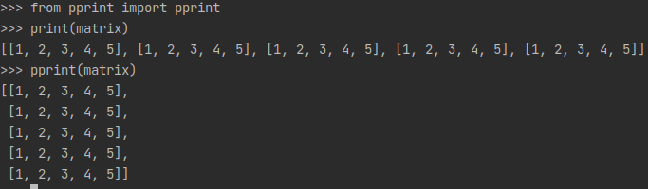
Pprint, because apes hate debuggers

Slide 21
Fractions : fractions
Some problems may need to use fractions, and it’s a pain in the ass to reimplement
Once again, the PSL has a solution !
>>> Fraction(2,6) - Fraction(1,12)
Fraction(1, 4)
>>> Fraction(2,6) * Fraction(1,12)
Fraction(1, 36)

Slide 22
Base64 : encode and decode raw bytes
Ever seen those sequences with `=` at the end ? That’s base64
import base64
a = base64.b64encode(b"Lalalala")
print(a)
print(base64.b64decode(a))

Slide 23


